Slide 1
RESUME BUILDER USING LARAVEL – MAKEMYCV
BY
S.NIRAIMADI
Reg.No : 180701073
Sri Venkateswara College of Engineering
COMPANY NAME : Exposys Data Labs
DURATION : 1 month

Slide 2
INTRODUCTION
Online Resume Builder is an application that simplifies the task of creating a resume for individuals.
The system is developed to provide an easy means for creating a professional looking resume.
Individuals just have to fill up the forms provided in each section that specifies questions from all required fields such as personal questions, educational qualifications, skills, projects and so on.
The answers provided by the users are stored and the system automatically generates a well-structured resume.
Users can see preview of their resume after filling up the details and they can download their resume in pdf format.

Slide 3
OBJECTIVES
  Provides instant resume to individuals.
  Reduces tedious work in thinking and creating resume.
  More Convenient for users.
  Provides a variety of templates.
  Provides quick access and is affordable.
  The system saves time and reduces human efforts.

Slide 4
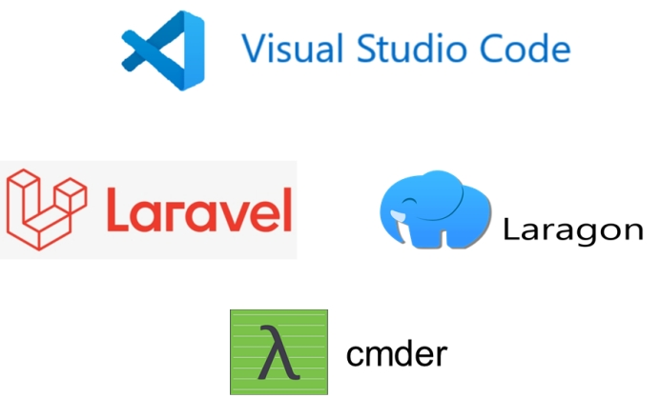
SOFTWARE USED
Code Editor - Visual Studio
Laravel
Laragon
Cmder

Slide 5
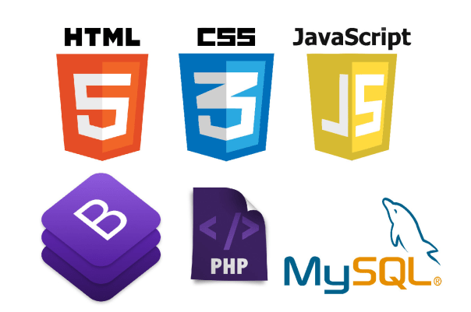
TECHNOLOGY USED
HTML
Bootstrap and CSS
PHP
JavaScript
MySQL
Apache2

Slide 6
MODULES
Home page with good UI.
Dashboard for user login and register.
Main Page with sections heading, education, experience, skills, projects, certifications containing forms to get the user details.
Preview button to preview the resume.
Button to select the template from the templates provided.
Download button to download the resume in pdf format.

Slide 7
WORK FLOW OF WEBSITE
To create an account users have to register by providing their name, email id.
They can login with their email id and password to create their resume.
Sections like heading, education, experience, skills, projects, certifications will be shown.
Users can enter their details and click on submit in each section to save their details.
They can preview their resume by clicking on the preview button on the navbar.
Users can select a template of their choice from the templates provided.
Users can download their resume in pdf format by clicking the download button.

Slide 8
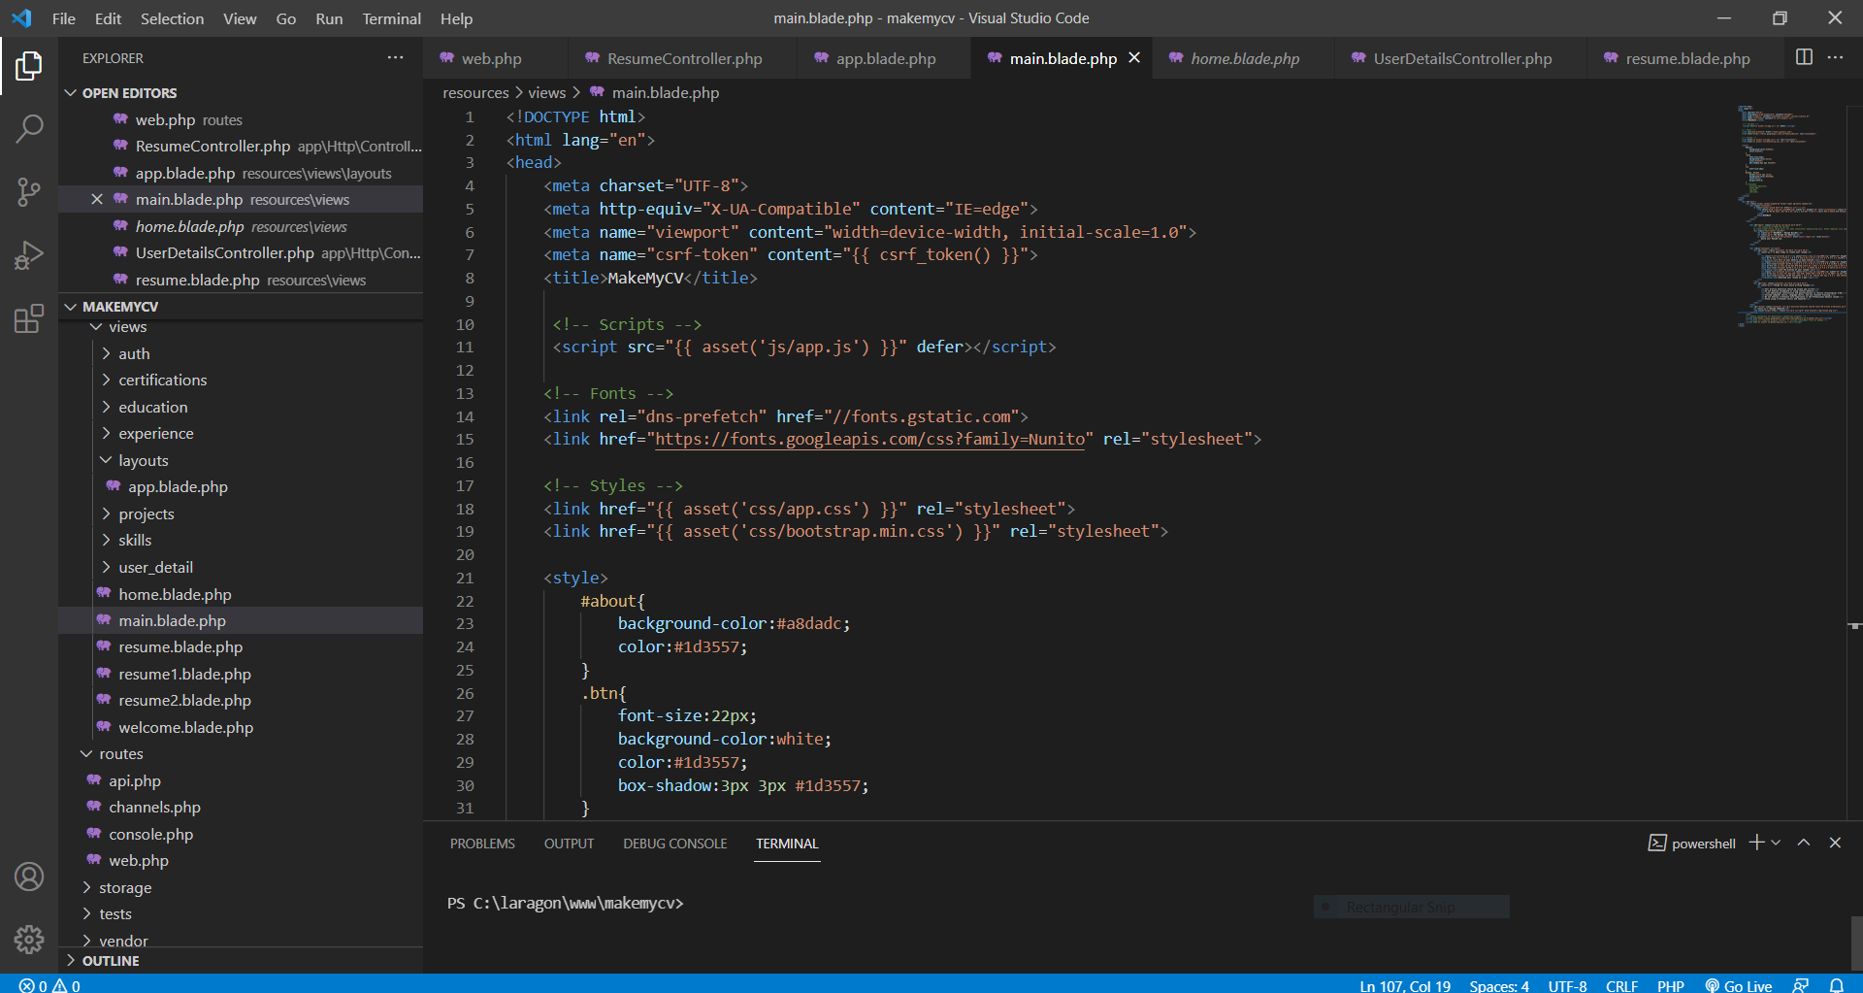
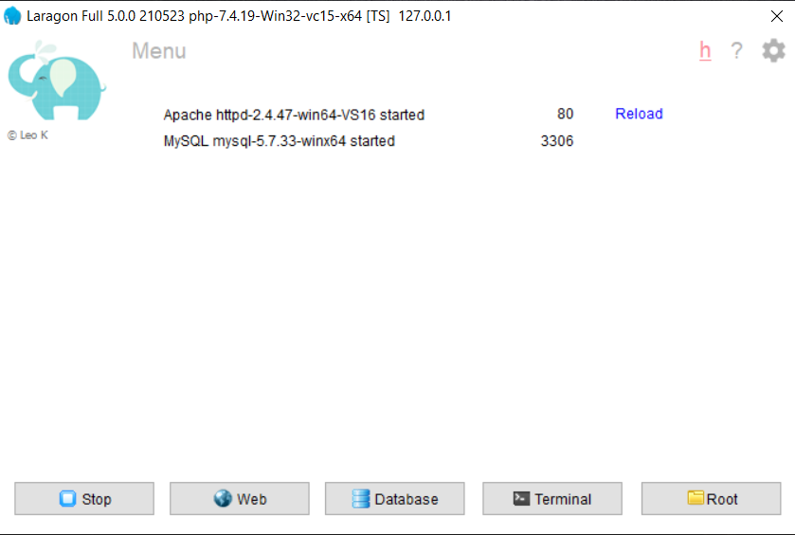
TOOLS USED
VISUAL STUDIO CODE
LARAGON

Slide 9
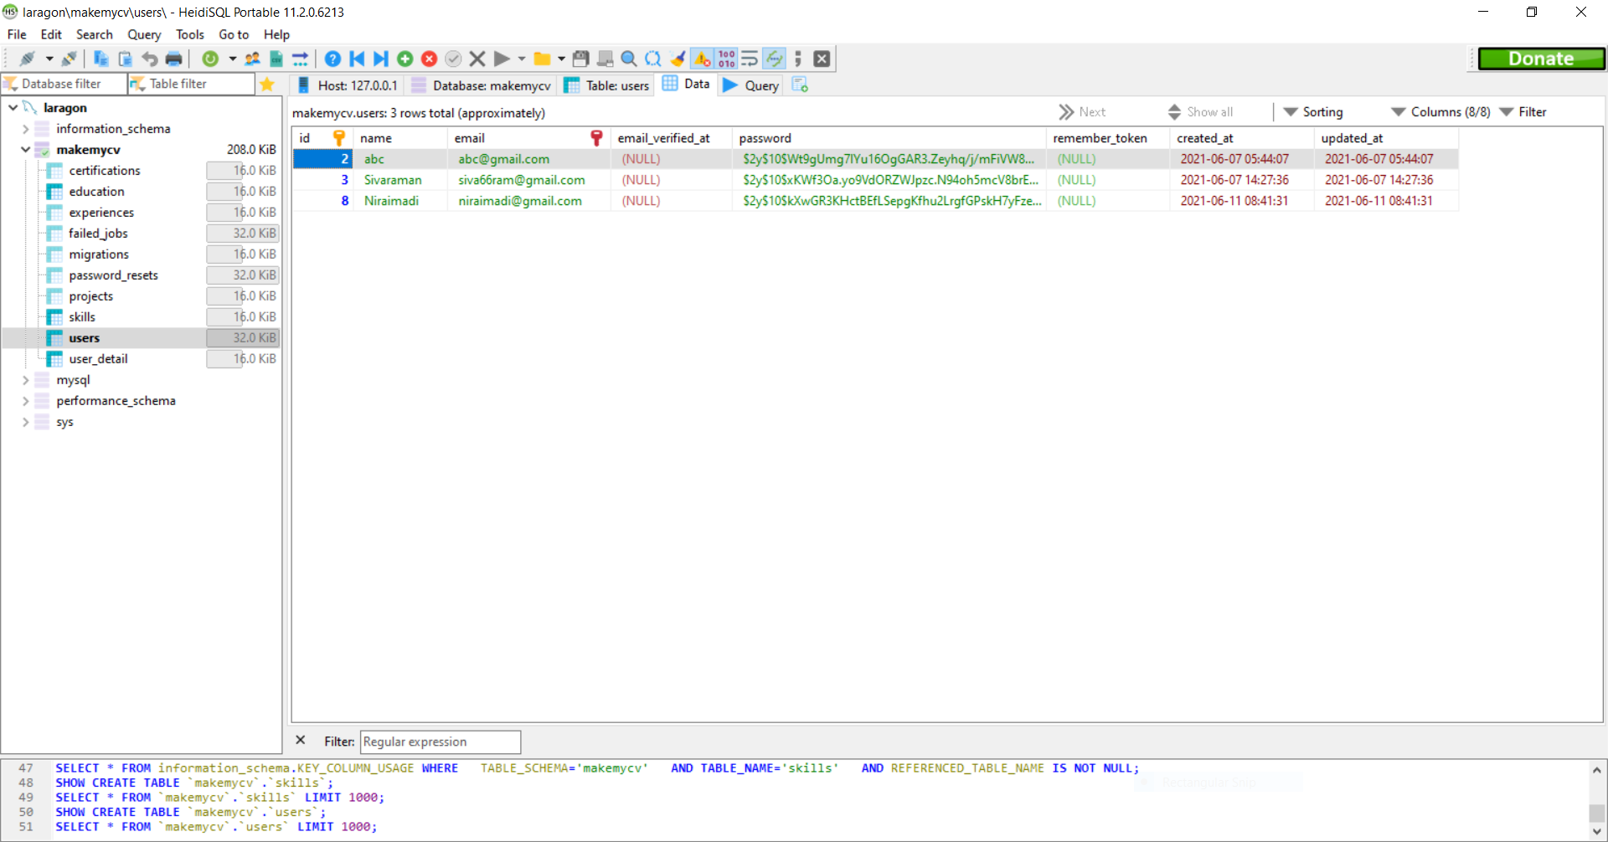
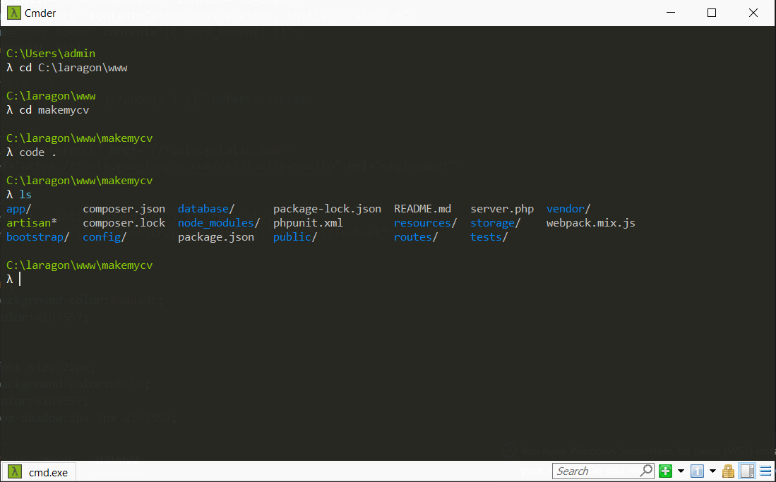
TOOLS USED
DATABASE
CMDER

Slide 10
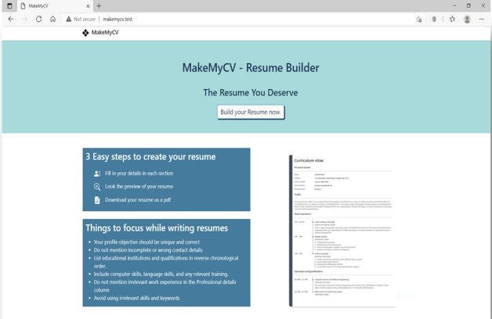
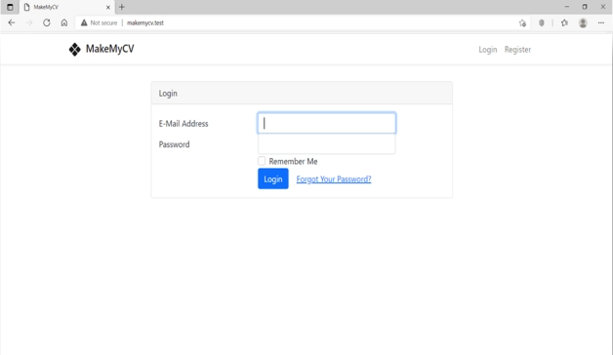
WEBSITE SCREENSHOT

Slide 11
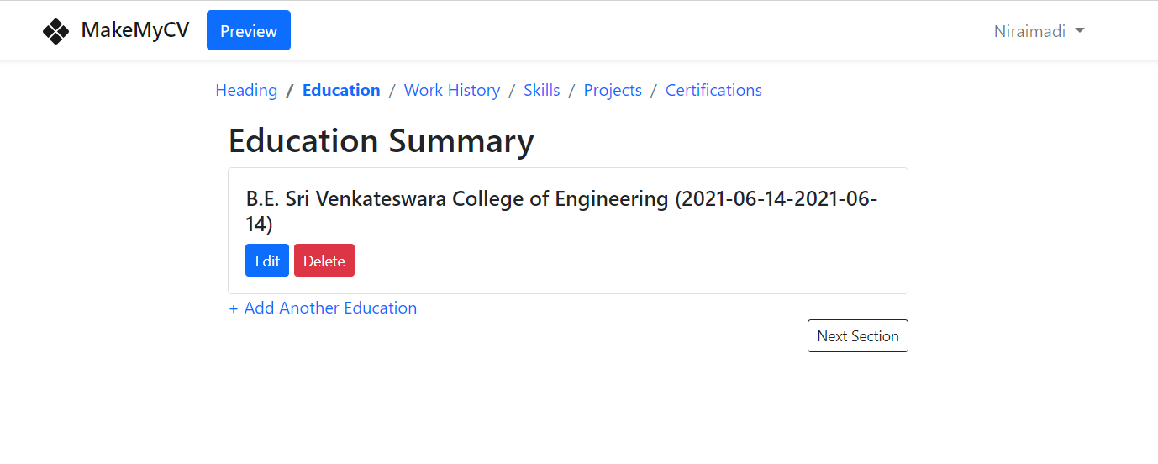
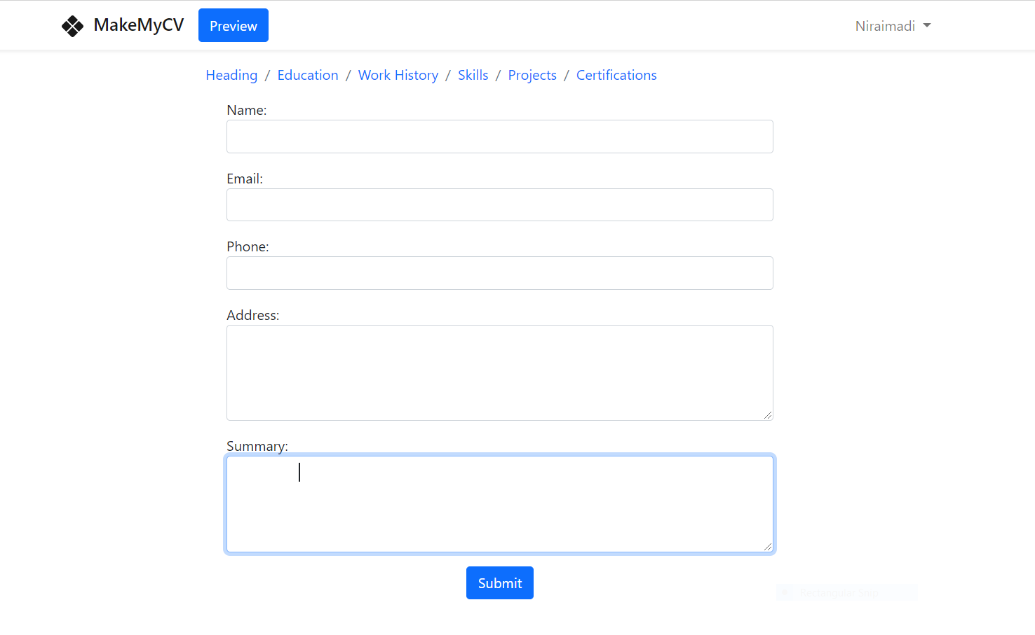
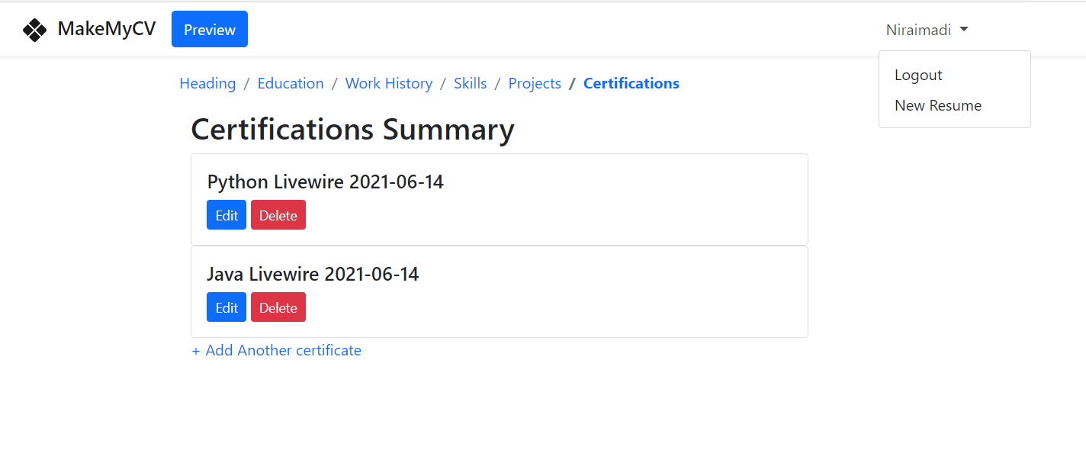
WEBSITE SCREENSHOT

Slide 12
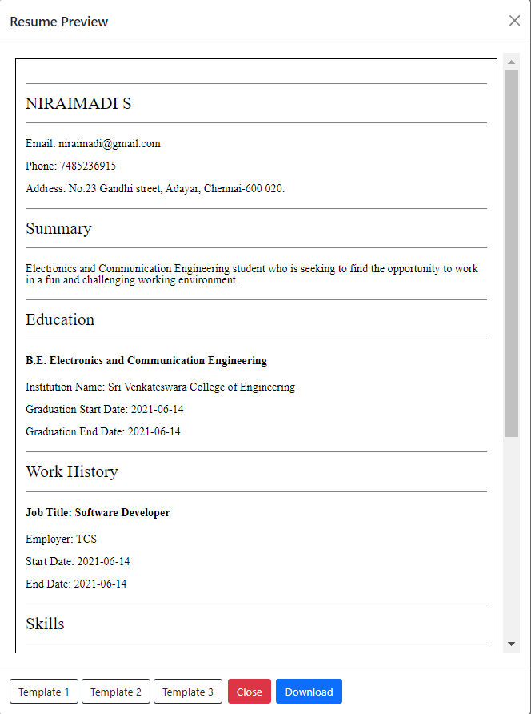
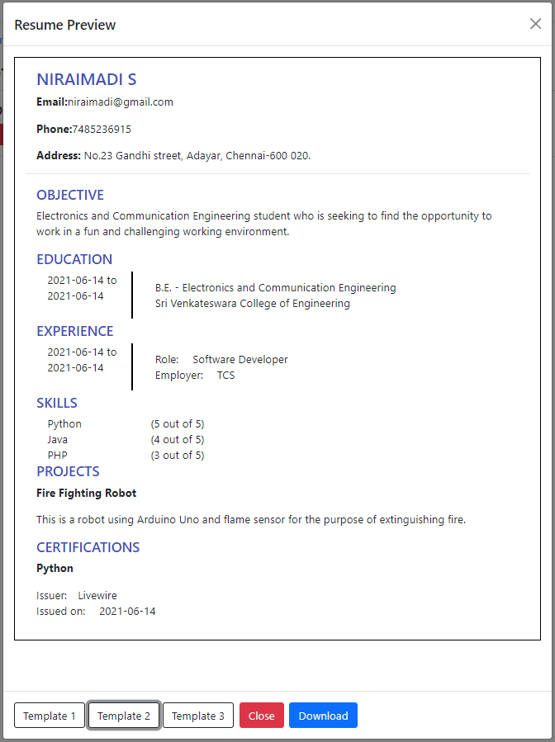
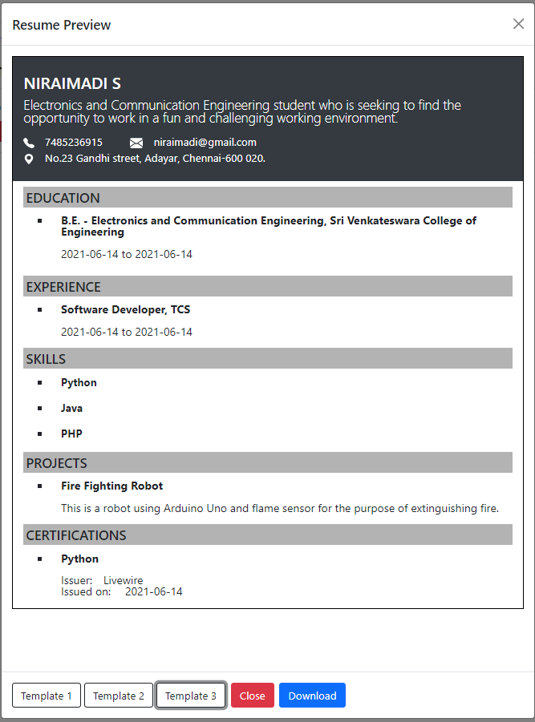
WEBSITE SCREENSHOT

Slide 13
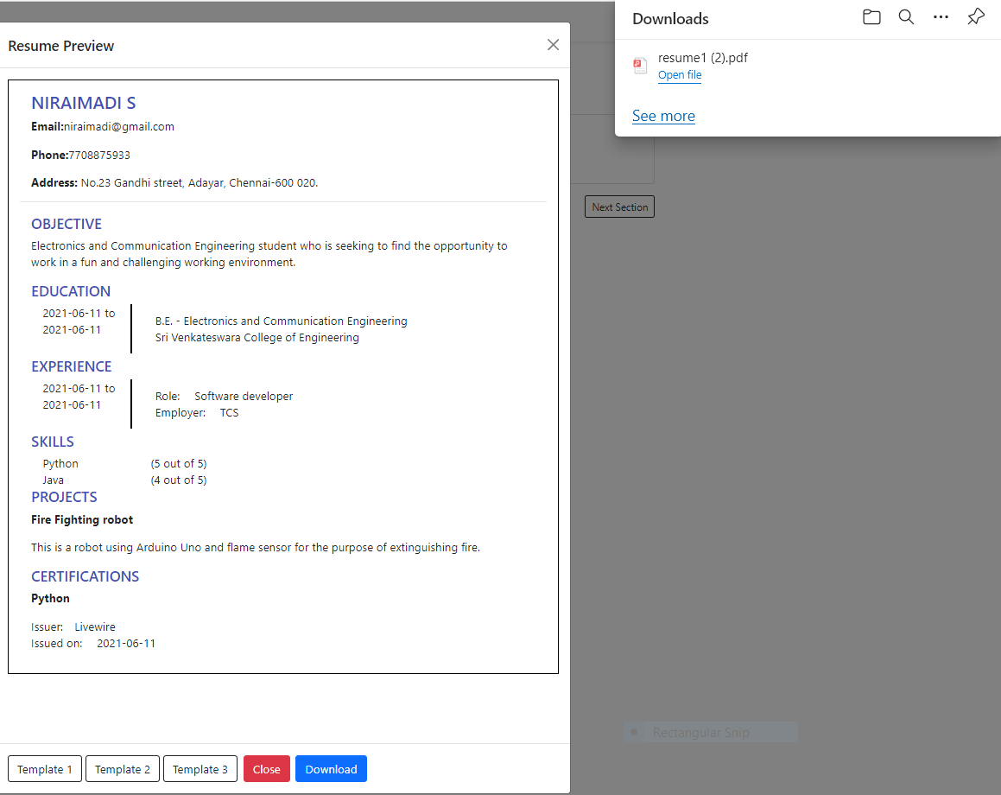
WEBSITE SCREENSHOT

Slide 14


